Slide 1
Orbital Maneuvering - Pointing Modes
NMSU
07/16/2021
1

Slide 2
ADCS Modes
Detumble
Sun point (Standby)
Ground station point (Communication)
GNSS receiver point (Maneuver)
Observation
**Momentum unloading by torque rods is default
**Sun pointing is the secondary requirement in the Ground station point and GNSS receiver point modes

Slide 3
ADCS State Diagram
Based on BCT Bus Modes and Transitions
Spacecraft Separation
Sun Safe
Standby
UHF Downlink
Primary/Secondary pointing requirements
Standby
Primary pointing: Solar panel to Sun
Secondary pointing: GNSS receiver to zenith
UHF Downlink
Primary pointing: UHF antenna to nadir
Secondary pointing: Solar panel to Sun
Maneuver
Primary pointing: GNSS receiver to zenith
Secondary pointing: Solar panel to Sun
Observation
Primary pointing: Boresight to Sun
Inertial hold
Maneuver
(Transfer/
Escape/
Science)
Survival
Key
Command
Autonomous
Error/Fault
Observation

Slide 4
GNC ConOps
Key
Command
Autonomous
Error/Fault
Active Collision Maneuver
Passive Relative Orbit Geometry (200 m)
Science Relative Orbit Geometry (40 m)
No Relative Orbit Geometry
Manual modes
Startup/Recovery/Decommissioning
Standby mode
Data downlink
Transfer mode
Orbit reconfiguration
Science/Observation mode
Collect science data
Escape mode
Collision avoidance
1
2
Autonomous
Modes
3
Manual
Modes
Preliminary Operations
Standby formation acquired
1
Standby
Transfer
3
Formation safety compromised, error, or low power
Completion
of science campaign or contingency
Science Formation established
Reacquisition
3
Escape
Science
3
2
Performing or completing science observation
3
Safe
1
Observation
2

Slide 5
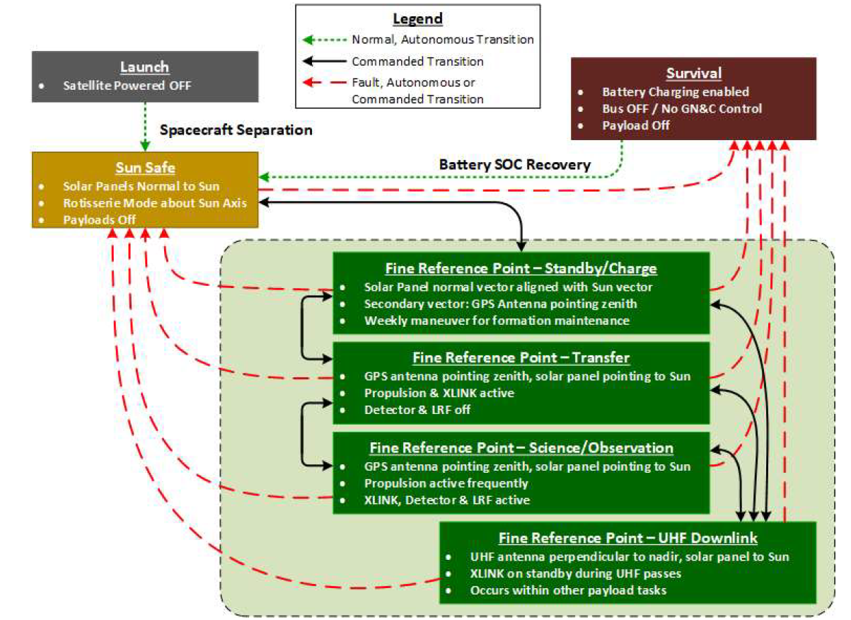
BCT Bus Modes and Transitions (PDR)

Slide 6
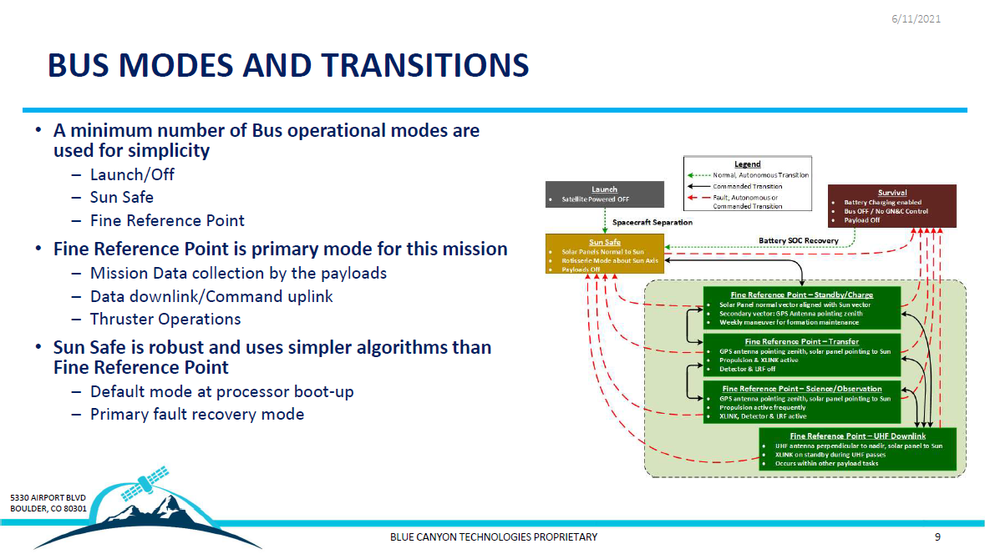

Slide 7
Backup Slides
7

Slide 8
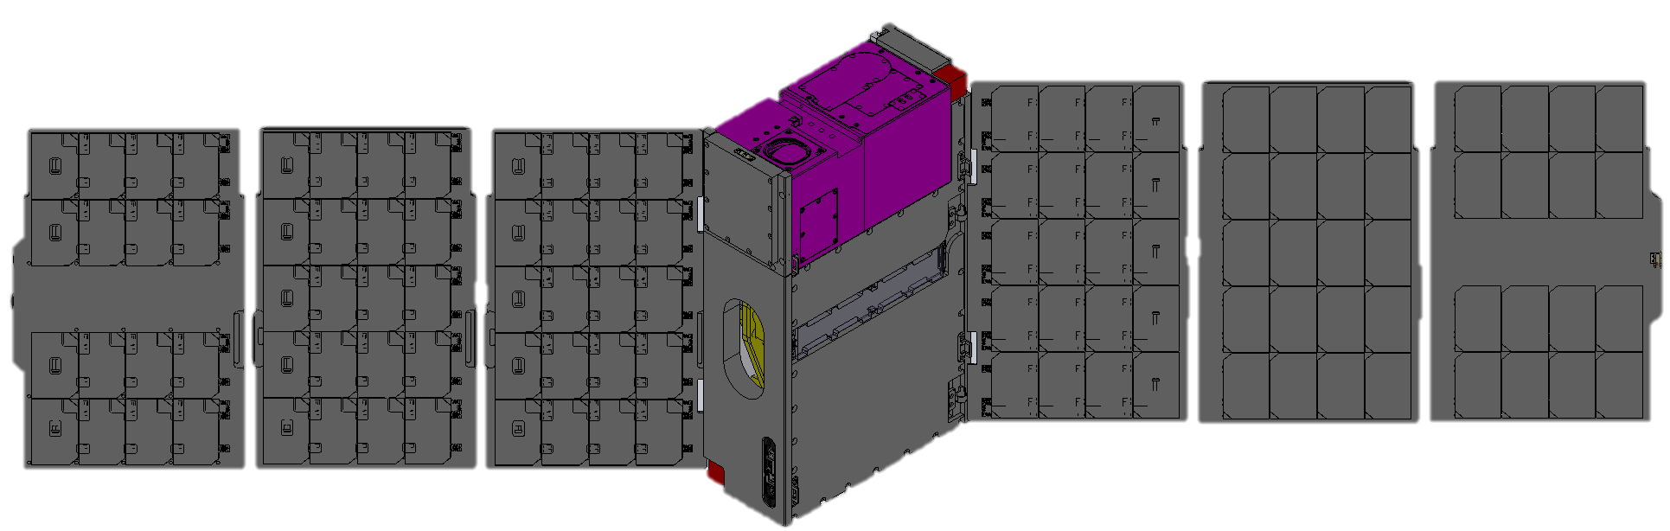
Important Pointing Vectors
DSC Body Frame
X
Y
Z
-Z
(out of page vector)
+Y
-X
Detector Boresight Vector = [-1, 0, 0]_{B}
Solar Panel Normal Vector = [-sqrt(2)/2, sqrt(2)/2, 0]_{B}
GNSS Receiver Vector = [0, 0, -1]_{B}
8
Notes:
8

Slide 9
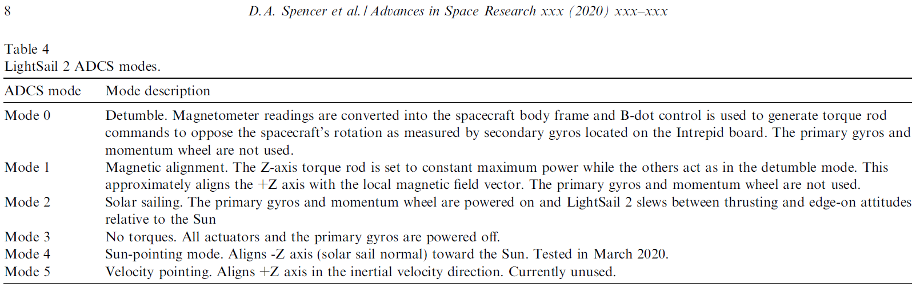
Previous Mission Example: LightSail 2

Slide 10
Pointing Requirements of DSC
Key
Command
Autonomous
Error/Fault
Active Collision Maneuver
Passive Relative Orbit Geometry (200 m)
Science Relative Orbit Geometry (40 m)
No Relative Orbit Geometry
Standby mode (data downlink)
Primary vector: UHF antenna to nadir
Secondary vector: Solar panel to Sun
Transfer mode (orbit reconfiguration)
Primary vector: GNSS receiver to zenith
Secondary vector: Solar panel to Sun
Science (collect science data)
Primary vector: GNSS receiver to zenith
Secondary vector: Solar panel to Sun
Observation mode (collect science data)
Primary vector: Boresight to Sun
Inertial hold
Escape mode (collision avoidance)
Primary vector: GNSS receiver to zenith
Secondary vector: Solar panel to Sun
1
2
Manual
Modes
Autonomous
Modes
3
Preliminary Operations
Standby formation acquired
Standby
Transfer
Formation safety compromised, error, or low power
Completion
of science campaign or contingency
Science Formation established
Reacquisition
Escape
Science
Performing or completing science observation
Safe
Observation

Slide 11
ADCS State Diagram (Previous Idea 1)
Spacecraft Separation
Detumble
Ground Station Point
GNSS Receiver Point
Transfer/ Science/ Escape
Safe
Standby
Key
Command
Autonomous
Error/Fault
Active Collision Maneuver
Sun Point
Charge
Observation
Secondary pointing requirements
Ground station point: Solar panel to Sun
GNSS receiver point: Solar panel to Sun
Sun point: GNSS receiver to zenith
Detumble & Observation: N/A
Possible topics to discuss
Combine Detumble and Sun point modes?
Simplify transition between Ground station point & GNSS receiver point modes?
Trigger conditions?
Any other things…
Science

Slide 12
ADCS State Diagram (Previous Idea 2)
Based on BCT Bus Modes and Transitions
Primary/Secondary pointing requirements
Survival
Standby& Charge
UHF Downlink
Maneuver
(Transfer/
Escape/
Science)
Sun Safe
Spacecraft Separation
Key
Command
Autonomous
Error/Fault
Observation

Slide 13
Example: GNSS Receiver Point Constraints
GNSS Receiver must be ±15º of the zenith direction
Use secondary pointing requirement to maximize power generation

Slide 14
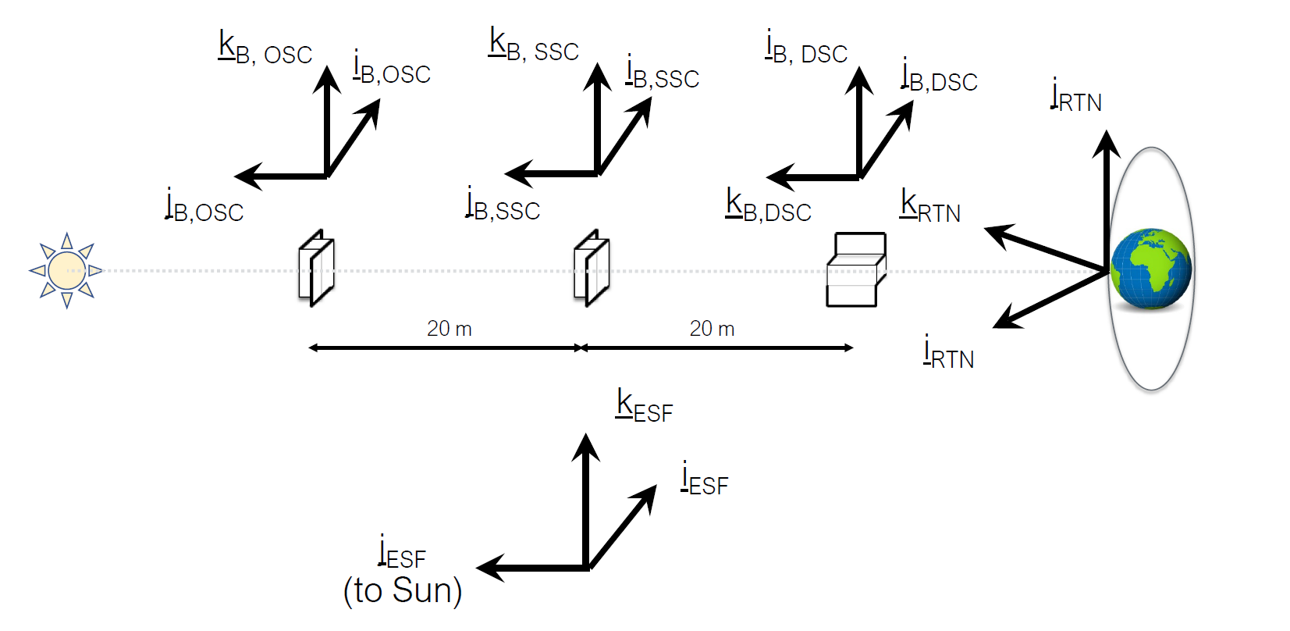
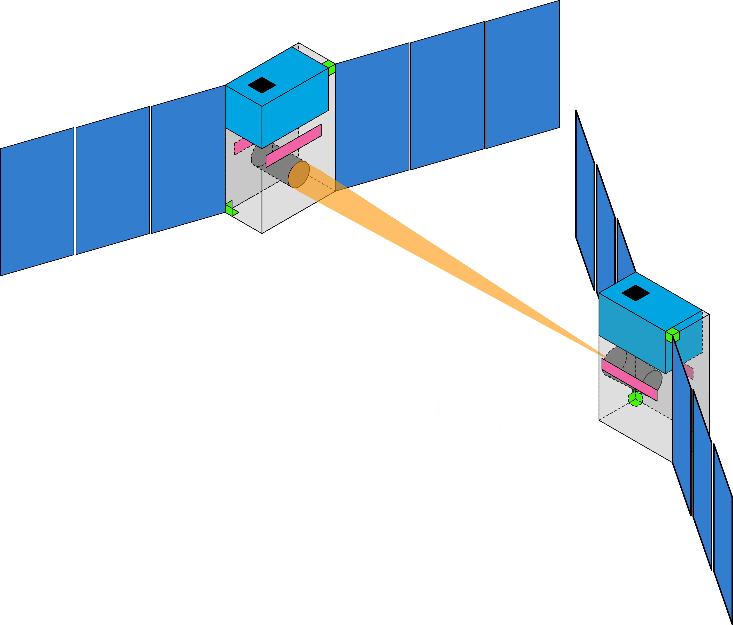

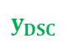
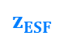
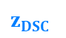
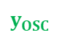


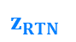

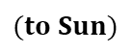



ADCS Modes – Observation Mode
$$x_{OSC}$$
$$z_{ESF}$$
Reference frames
Earth Sun frame (ESF)
Radial Tangential Normal (RTN) frame
Detector S/C (DSC) frame
Optics S/C (OSC) frame
$$y_{OSC}$$
$$(to Sun)$$
$$z_{OSC}$$
$$y_{ESF}$$
$$x_{ESF}$$
$$y_{DSC}$$
$$x_{DSC}$$
$$z_{DSC}$$
$$y_{RTN}$$
40 m
$$z_{RTN}$$
$$x_{RTN}$$

Slide 15
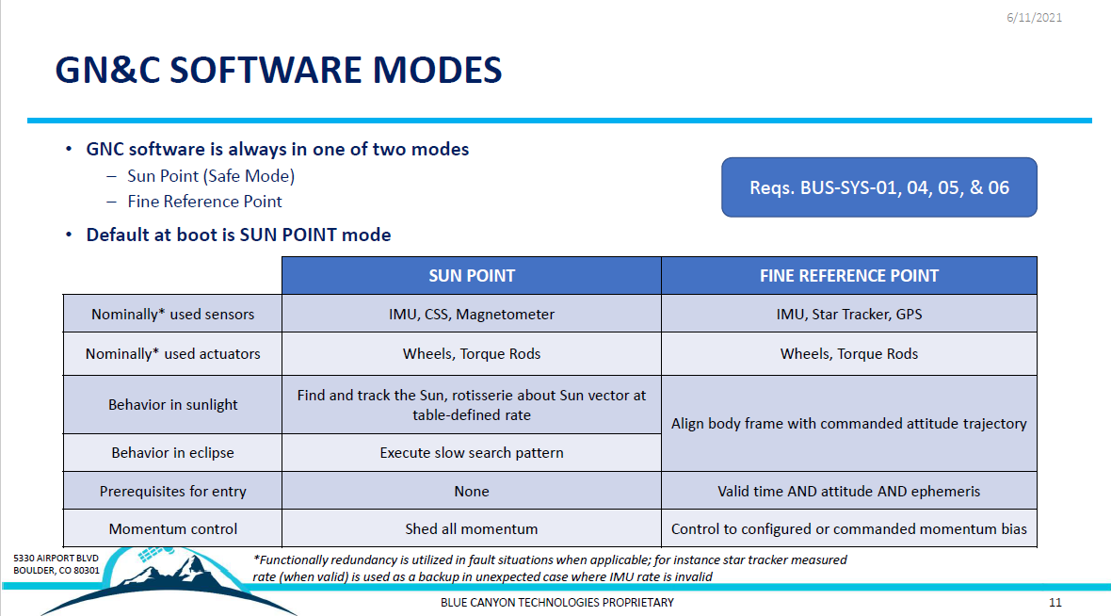

Slide 16
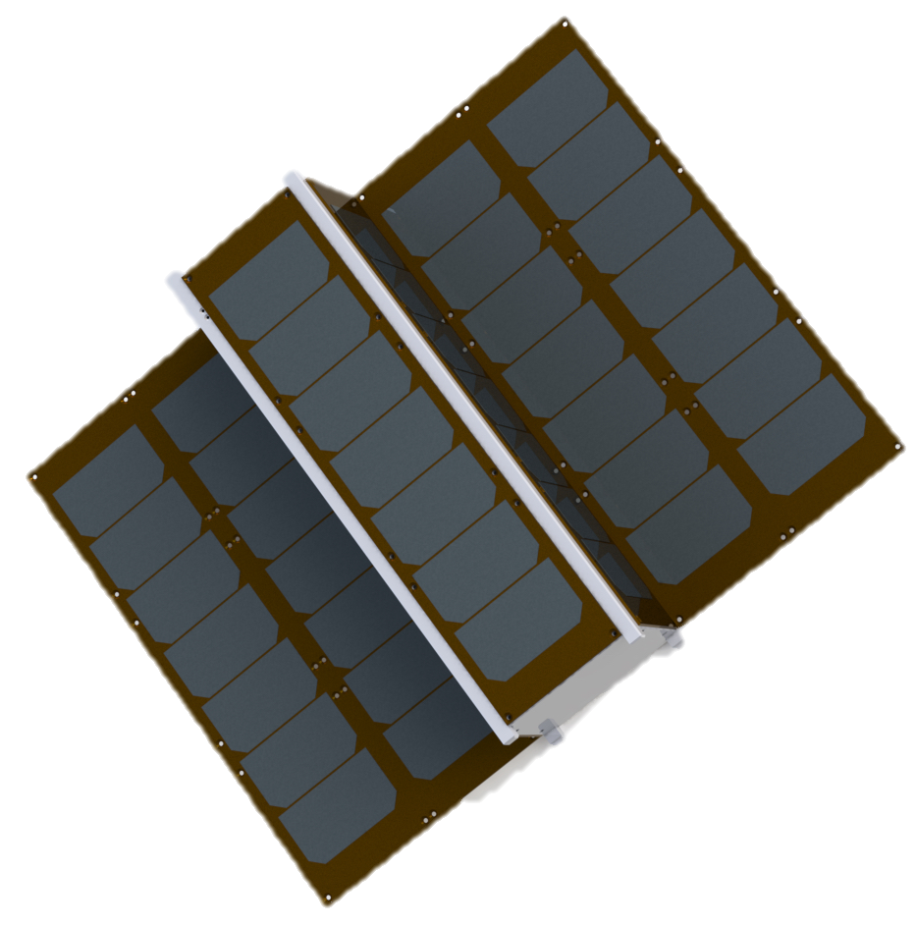
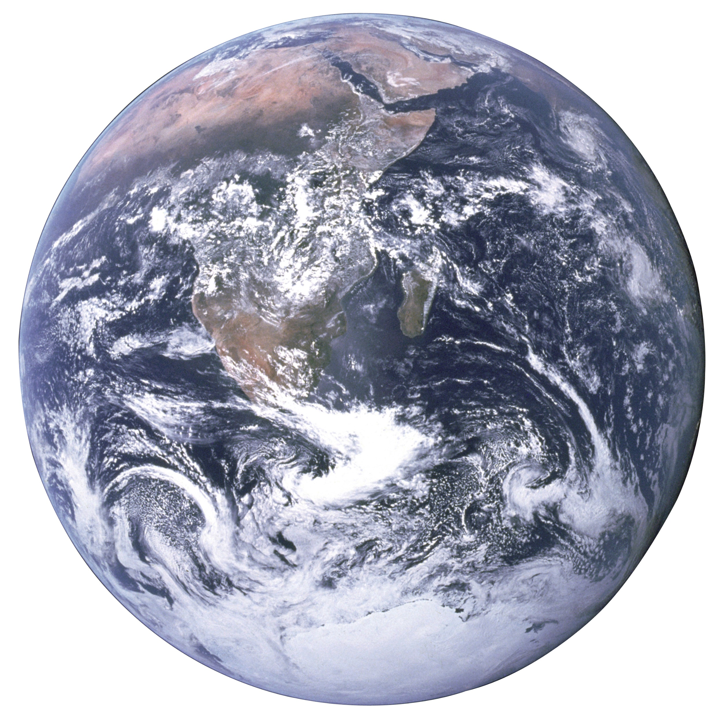
Example of Maneuver Command
Axis definitions
R – Aligned with position vector from earth’s center
N – Aligned with orbit angular momentum vector
T – Completes right-handed triad (nominally near velocity direction)
Example maneuver table
LVLH frame
Time (s) | 100 | 500 | 760.2 | 1000
R (m/s) | 0.1 | -0.2 | 0.15 | 0.4
T (m/s) | 0.4 | 0.1 | -0.2 | 0.15
N (m/s) | 0.15 | 0.4 | 0.1 | -0.2
R
T
N

Slide 17
Orbit Parameters
Altitude: 550km
Sun-synchronous inclination: 97.4º
Nominal Epoch: 3/21/2024
LTAN: 9AM
Input parameter: RAAN 315º
17
Notes:
17

